Slide 1
What’s missing?

Slide 2
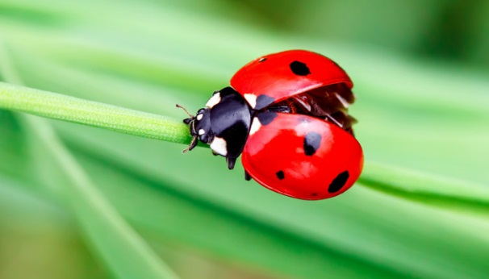
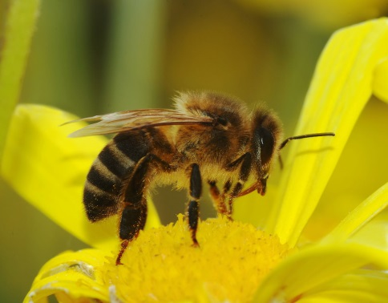
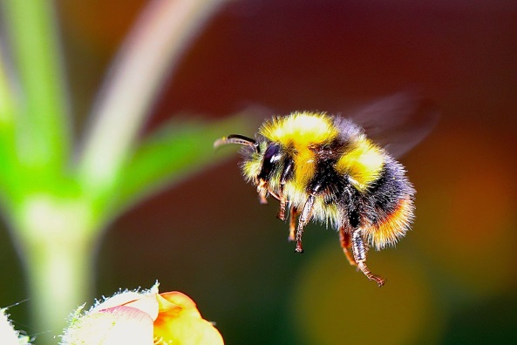

Slide 3
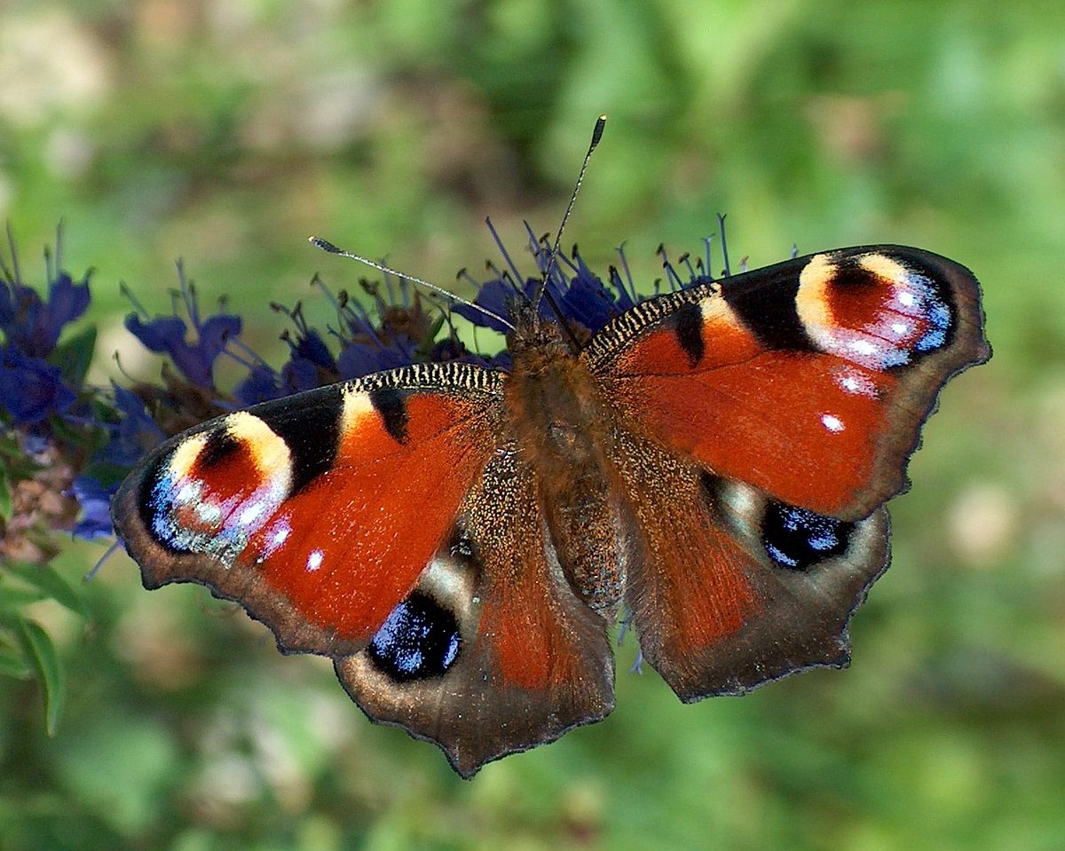
butterfly!

Slide 5
bee!

Slide 7
ladybug!

Slide 9
bumblebee!

